Slide 1


Background

Slide 2


1. Background color

Slide 3
Topics
Background color
Background image
Background repeat
Background attachment
Background position
Background shorthand

Slide 4
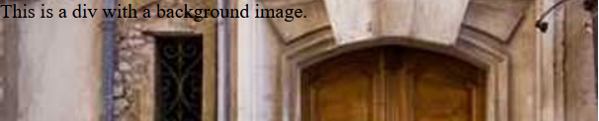
2. Background image

Slide 5
3. Background repeat
repeat
repeat-x
repeat-y
no-repeat

Slide 6
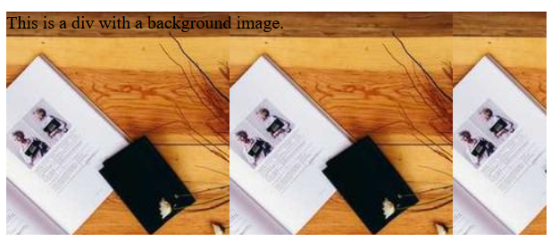
Example for repeat-x

Slide 7
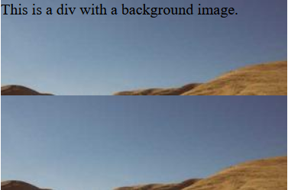
Example for repeat-y

Slide 8

Example for no-repeat

Slide 9
4. Background attachment
scroll
fixed

Slide 10
Example for background-attachment: scroll;

Slide 11
Example for background-attachment: fixed;

Slide 12
5. Background position
/* Keyword values */
background-position: top;
background-position: bottom;
background-position: left;
background-position: right;
background-position: center;
/* <percentage> values */
background-position: 25% 75%;
/* Edge offsets values */
background-position: bottom 10px right 20px;

Slide 13
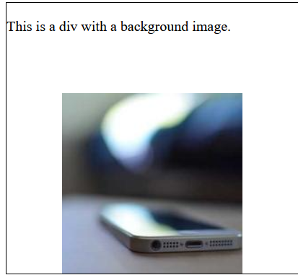
Here are some examples of different background-position values:
1. Example for position bottom

Slide 14
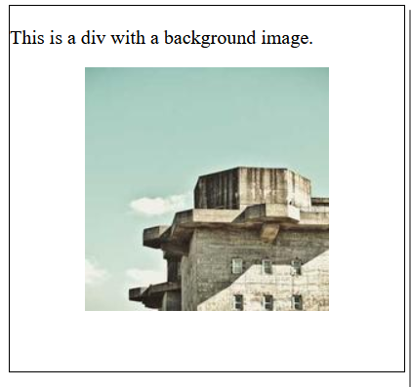
2. Example for percentage values

Slide 15
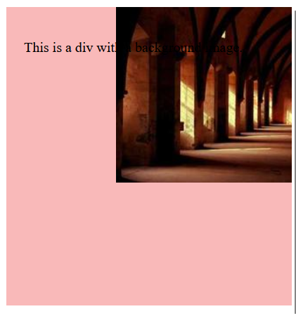
6. Background shorthand
Syntex
background: <background-color> <background-image> <background-repeat> <background-attachment> <background-position>;

Slide 16

THANK YOU

